Slide 1
Naive Bayes Classifier
By Mohammed Munavar

Slide 2
1. Introduction to Naive Bayes:
Naive Bayes is a probabilistic machine learning algorithm based on Bayes' Theorem.
It is commonly used for classification tasks and is particularly popular for text classification.

Slide 3
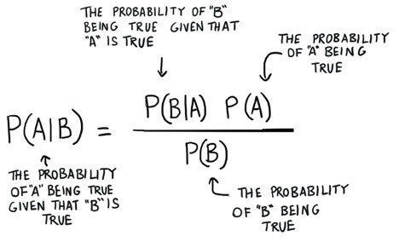
2. How Naive Bayes Works:
Naive Bayes works by calculating the probability of a data point belonging to each class based on its feature values.
It assumes that the features are conditionally independent given the class, which is why it's called "naive."
The class with the highest probability is then assigned to the data point.

Slide 4
3. Key Concepts:
Bayes' Theorem: Mathematical formula for calculating conditional probabilities.
Conditional Independence: Assumption that the features are independent given the class label.
-Prior and Posterior Probabilities: Prior probability is the initial belief, and posterior probability is the updated belief after observing the evidence (features).

Slide 5
Types of Naive Bayes:
Gaussian Naive Bayes: Assumes that the features follow a Gaussian distribution.
Multinomial Naive Bayes: Suitable for discrete features (e.g., word counts in text classification).
Bernoulli Naive Bayes: Applicable when features are binary (e.g., presence or absence of a word in text).

Slide 6
5. Advantages of Naive Bayes:
Simple and easy to implement.
Fast training and prediction times.
Works well with high-dimensional data.
Robust to irrelevant features.

Slide 7
6. Applications of Naive Bayes:
Text classification (spam detection, sentiment analysis).
Document categorization.
Medical diagnosis.
Customer segmentation.
Recommendation systems.

Slide 8
7. Considerations:
Assumes independence between features, which may not hold true in real-world data.
Sensitive to the quality of the training data, especially when dealing with rare events.
Can struggle with numerical features that don't follow a Gaussian distribution.

Slide 9
8. Conclusion:
Naive Bayes is a powerful and efficient algorithm for classification tasks, especially in scenarios with high-dimensional data and text classification problems.
While its assumption of feature independence may not always hold true, Naive Bayes often provides competitive performance with minimal computational overhead.

